Slide 1


Session #3:
Our first C# program.
C# program anatomy basic.
Data types and Variables.

Slide 2
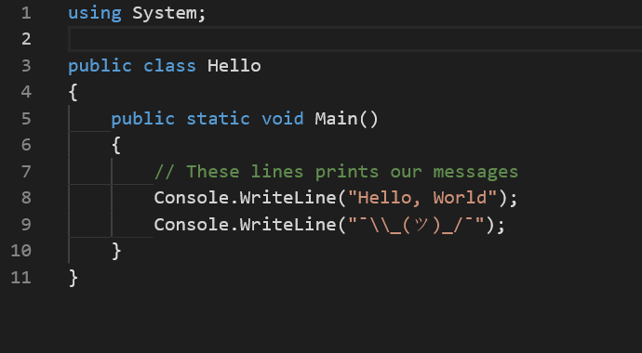
Our first C# program.

Slide 3
C# program anatomy basic.
The “using” statement.
Comments.
C# is case sensitive.
Solution and Project files/folders.

Slide 4
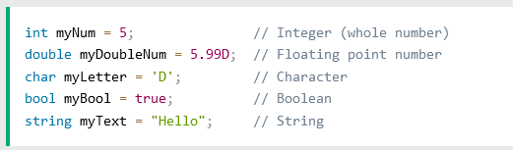
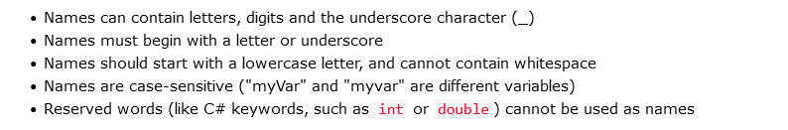
C# basic (value) types.

